Slide 1
GROUP - 5
AI POWERED MULTILINGUAL CYBERBULLYING DETECTOR
PROJECT GUIDE : DR. TRUPTI LOTLIKAR
SANIA MUSLIAR - 5024139
NAVYA ROSHNI - 5024142
VISHAKHA TALELE - 5024163
TANAYA DESHMUKH - 5024168

Slide 2
ABSTRACT
GROUP - 5
Our project leverages Artificial Intelligence (AI) and Natural Language Processing (NLP) to enable real-time detection of toxic or harmful content in online conversations. By integrating a multilingual model, the system can accurately identify and filter abusive, hateful, or harassing language across a wide range of languages, ensuring inclusivity and global applicability. Unlike static or single-language systems, our solution is designed to work seamlessly across multiple social media platforms through a browser extension, allowing users to experience safe and respectful online interactions without platform restrictions. Additionally, it provides instant alerts and filters out offensive content before the user even reads it, helping to reduce emotional distress and promote a healthier digital environment.

Slide 3

PROBLEM STATEMENT
GROUP - 5
Cyberbullying and toxic interactions are globes on multilingual platforms.
1.
Current detection systems are language-specific, lack real-time intervention, and do not provide user friendly solutions for blocking harmful content.
2.
An AI-powered, multilingual, real-time. detection tool is required to address toxic behavior across various online environments.
3.

Slide 4
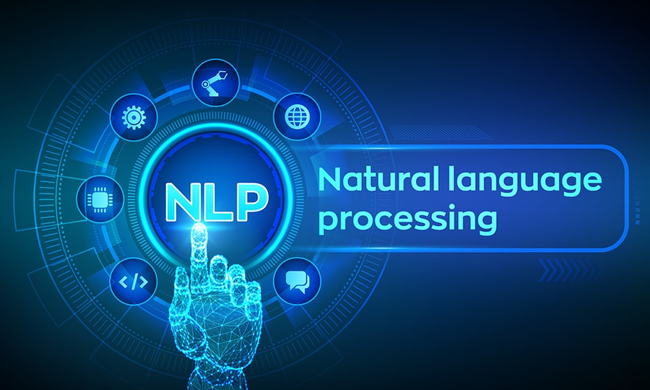
INTRODUCTION
GROUP - 5
Rise of social media usage across
age groups.
1.
2.
Increase in cyberbullying and toxic online behavior.
Need for real-time, multilingual,
context-aware solutions.
3.

Slide 5
LITERATURE
SURVEY
GROUP - 5
Sr. no. | Title, Author, Year | Key Ideas | Advantages | Limitations
1. | Cyberbullying Detection of Resource-Constrained Language from Social Media using Transformer-Based Approach Sihab-Us-Sakib et al., 2024 | Developed a transformer-based approach (XLM-RoBERTa) for Bengali cyberbullying detection. Compared ML (SVM, NB, RF) and deep models (CNN, LSTM, BiLSTM, GRU) with multilingual transformers. | XLM-RoBERTa achieved highest F1 = 0.83, Accuracy = 82.61%. Handles sarcasm and context better. Suitable for low-resource languages. | Limited to Bengali. Small dataset (2751 comments). Offline-only. No real-time testing or deployment.
2. | BullStop: A Mobile App for Cyberbullying Prevention Semiu Salawu, Yulan He & Jo Lumsden, 2020 | mobile app integrating deep learning models (BERT, RoBERTa, XLNet, DistilBERT) for real-time cyberbullying detection. Designed with a microservices architecture allowing model scalability and plug-and-play classifiers. Implemented online retraining using user feedback. | First real-world deployable mobile app for cyberbullying prevention. Integrated with Twitter API, enabling real-time detection, deletion, and blocking. Freely available on Google Play. | Restricted to English Twitter data. Accuracy moderate (≈58%, macro-F1=0.54). Limited multilingual and cross-platform applicability.

Slide 6
GROUP - 5
Sr. no. | Title, Author, Year | Key Ideas | Advantages | Limitations
3. | Intelligent Multi-Lingual Cyber-Hate Detection in Online Social Networks: Taxonomy, Approaches, Datasets, and Open Challenges Donia Gamal et al., 2023 | Comprehensive survey of multilingual hate detection techniques and datasets across 25+ languages. Discussed ML, DL, lexicon-based, and hybrid models. Proposed taxonomy for 10 hate types. | Identified global datasets, transformer applications (BERT, XLM-R), and multilingual challenges. Gave overview of latest approaches. | Purely theoretical. No implementation or evaluation. Lacked deployment or real-time model validation.
4. | Advancing Cyberbullying Detection: A Hybrid Machine Learning and Deep Learning Framework for Social Media Analysis Bishal Shyam Purkayastha et al., 2025 | Designed a hybrid framework combining ML (Random Forest, XGBoost, AdaBoost) and DL (BiLSTM, BiGRU, BERT) for cyberbullying detection. Used two datasets (Mandalay and Kaggle). Employed preprocessing, random oversampling, and XAI for interpretability. | Achieved 91.36% accuracy and 91.24% F1-score with BERT model. Balanced dataset and interpretability using SHAP/LIME. Demonstrated hybrid ML-DL performance. | Focused on English-only datasets. Offline, no real-time or multilingual capabilities. Computationally heavy due to hybrid design. No deployment in live environments.

Slide 7

EXISTING SYSTEMS
GROUP - 5
BULLSTOP : A MOBILE APP DEVELOPMENT FOR CYBERBULLYING
FACEBOOK : DEEP TEXT
TRANSFORMER-BASED BENGALI CYBERBULLYING DETECTOR
HYBRID ML–DL FRAMEWORK COMBINING MODELS LIKE BERT, BILSTM, AND RANDOM FOREST FOR CYBERBULLYING DETECTION.

Slide 8
OBJECTIVES
GROUP - 5
  Detect and classify toxic content in real-time.
  Support multiple languages with contextual accuracy.
  Alert users before harmful exposure.
  Ensure platform independence via browser extension.
  Show comments in an admin dashboard.
  Export comments as dataset for retraining.

Slide 9
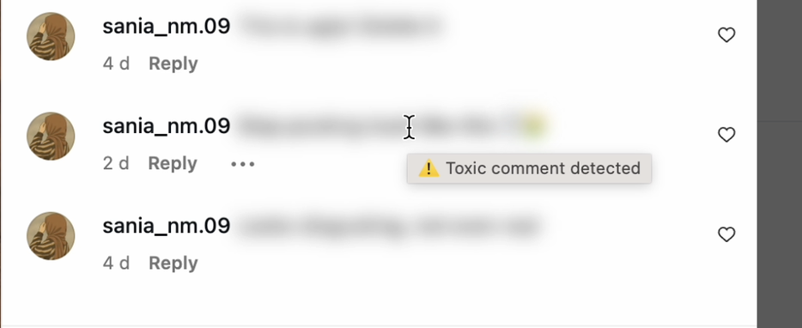
PROPOSED
GROUP - 5
SYSTEM
  Detects and filters toxic or bullying comments across multiple languages in real time.
  Implemented as a browser extension integrated with a fine-tuned NLP model.
  Computes a toxicity score and categorizes comments into Low, Moderate, and High levels.
  Automatically blurs toxic comments while showing warnings and a “View” option for user control.
  Aims to create a safer and more positive online environment.

Slide 10
PROPOSED
GROUP - 5
SYSTEM
SYSTEM OVERVIEW:
1. Backend – AI Model + Flask API
  Uses XLM-RoBERTa (multilingual transformer model) from Hugging Face.
  Fine-tuned on multilingual datasets (English, Hindi, Bengali, Arabic, German).
  Enhances understanding of regional slang, expressions, and code-mixed text.
  An API that predicts toxicity from input text.
2. Frontend – Browser Extension
  Developed using HTML, CSS, and JavaScript.
  Scans visible comments on social media platforms (Instagram, YouTube, X).
  Sends each comment to the Flask API for classification.
  Toxic comments are blurred or hidden, with a warning message shown.
  Users can reveal comments manually, ensuring transparency and control.

Slide 11
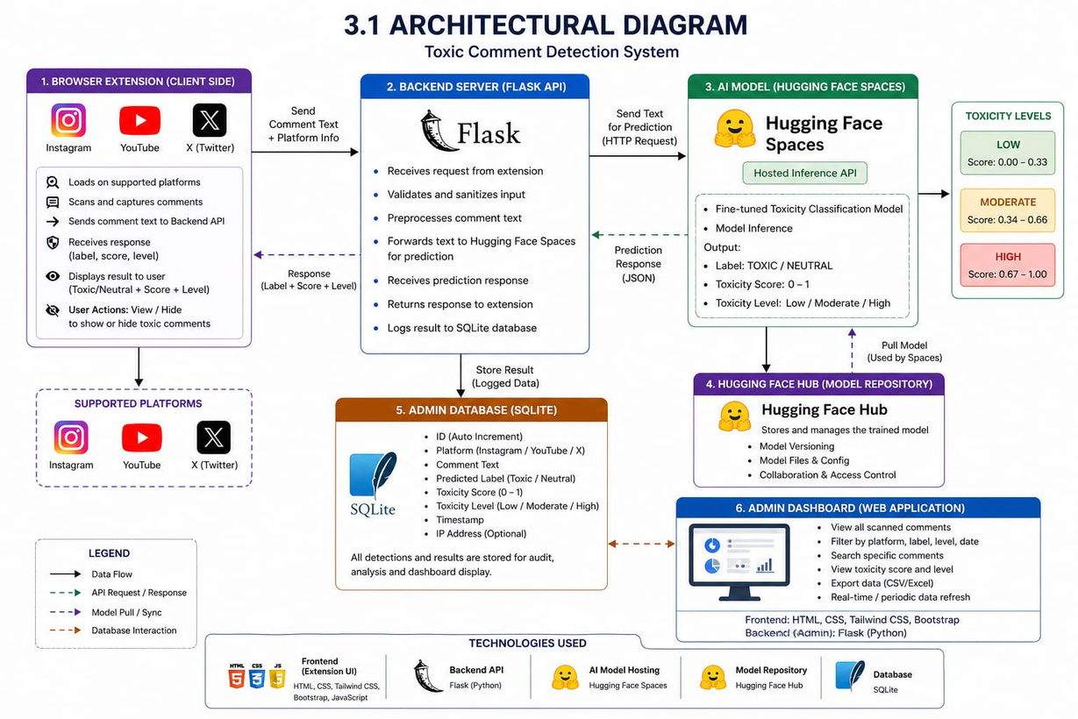
GROUP - 5
TECHNICAL APPROACH
FRONTEND (BROWSER EXTENSION) :
The browser extension scans and captures comments from web pages in real time and sends them for analysis.
BACKEND & AI MODEL :
The Flask backend receives the comment, processes it using an AI/NLP model, and classifies it (e.g., toxic or neutral).
COMMENT PROCESSING & DETECTION :
Comments are cleaned and analyzed using a fine-tuned XLM-RoBERTa model for toxicity detection.
SCORING & CLASSIFICATION :
A weighted scoring method calculates toxicity level (Low / Moderate / High).
RESPONSE & UI UPDATE :
Toxic comments are blurred with warning, score, and “View” option displayed to the user.
STORAGE & MONITORING :
Results are stored in a database for logging and admin dashboard monitoring.

Slide 12
GROUP - 5
MODERN TOOLS
1.
FRAMEWORKS AND LIBRARIES
2.
APIS AND SERVICES
3.
SOFTWARE
4.
HARDWARE
  Flask – for Backend API handling
  Transformers (Hugging Face) – for loading and using pre-trained toxicity detection models
  PyTorch – for deep learning model inference
  Hugging Face Model API (textdetox/xlmr-large-toxicity-classifier) – for text toxicity prediction
  Chrome Extension API – for interacting with browser DOM and permissions
  Frontend (Extension) : HTML, CSS, JavaScript
  Backend (API) : Python (Flask)
  Hugging Face Spaces - for cloud deployment and model hosting
  Browser Platform : Google Chrome
  Database : SQLite
  Development Tools : Chrome Developer Tools, VS Code
  Operating System :
Windows 10 / 11
  Processor : Dual-core or higher
  RAM : Minimum 4 GB RAM

Slide 13
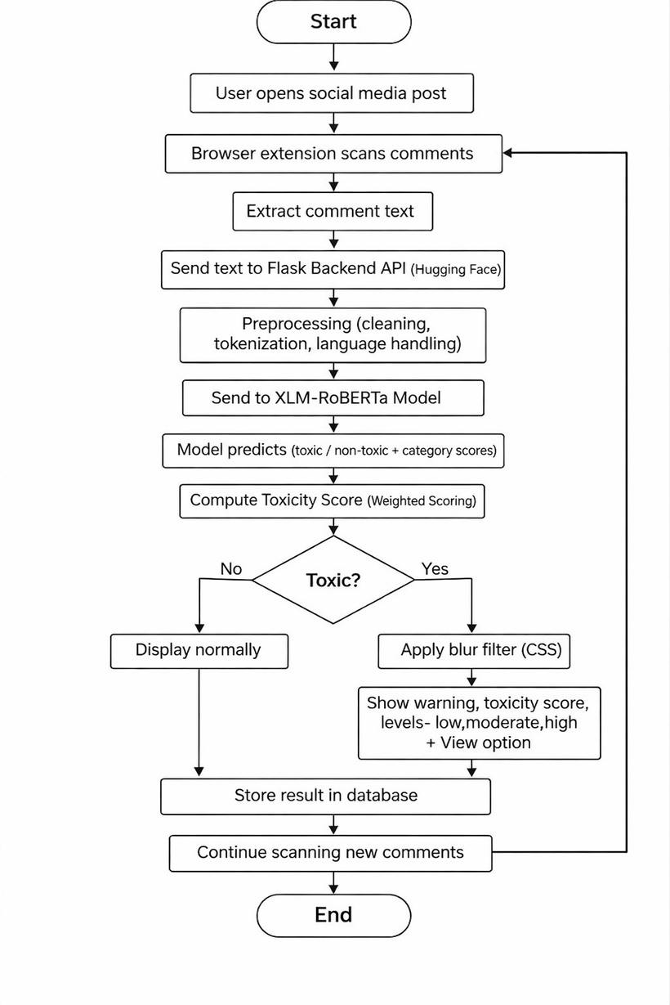
IMPLEMENTATION DETAILS
FLOWCHART

Slide 14
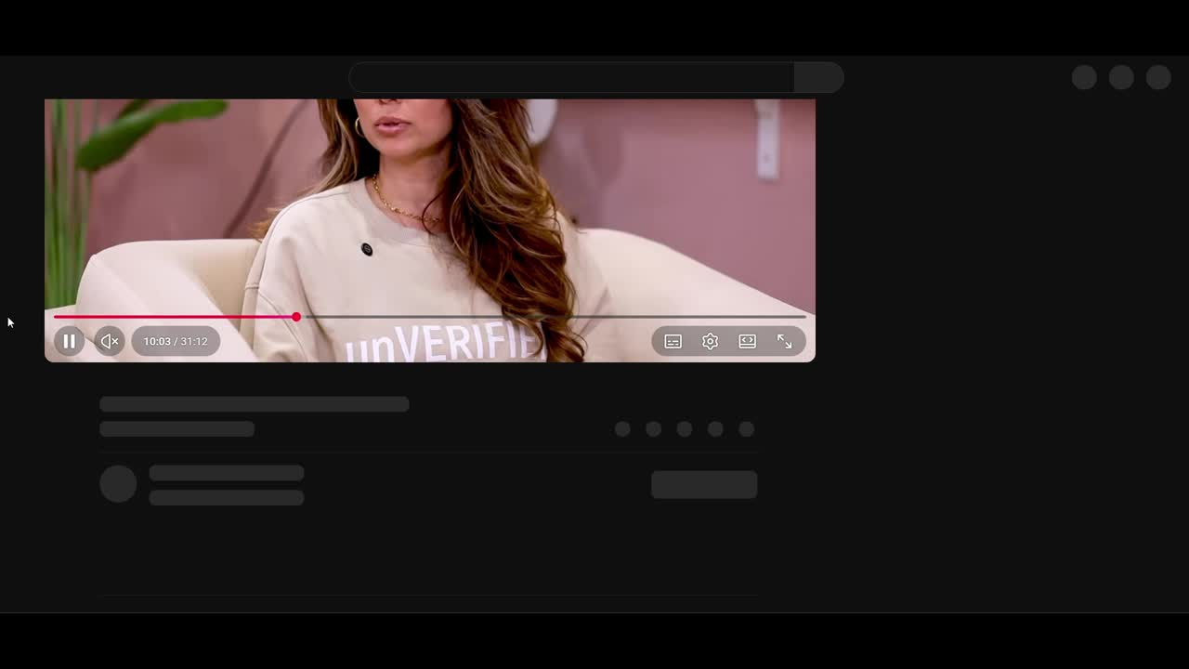

Slide 15
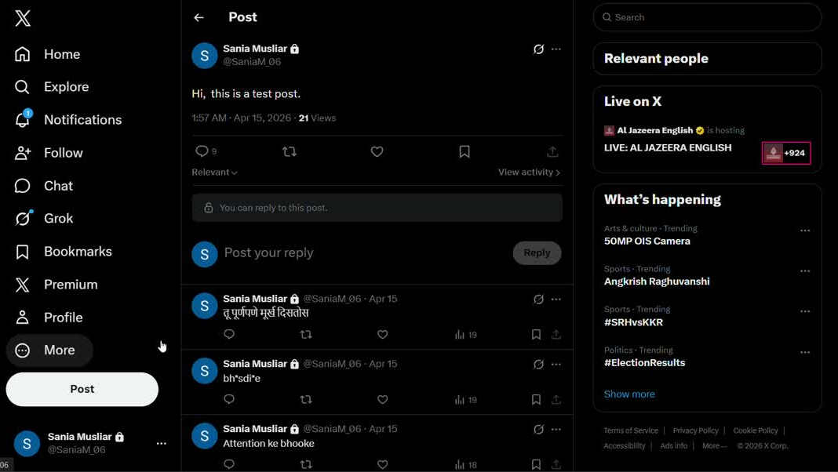

Slide 16
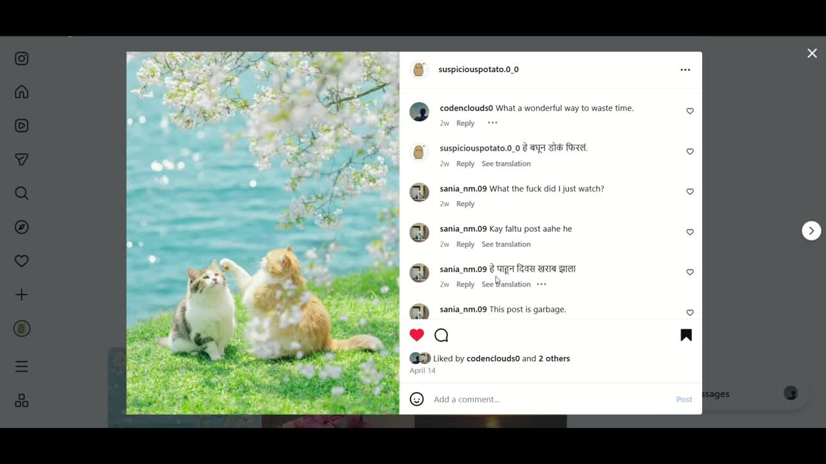

Slide 17
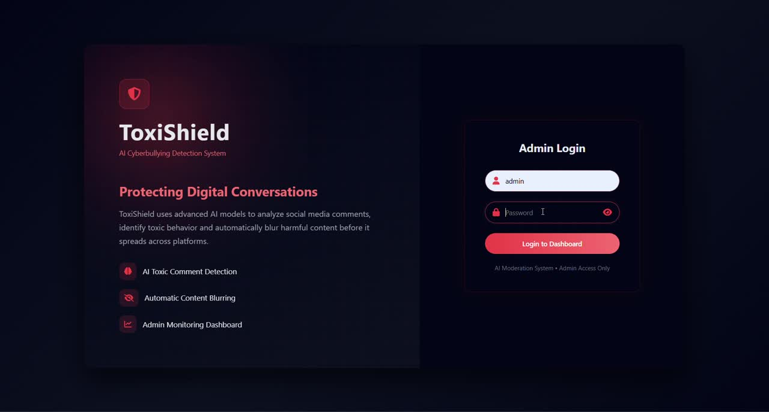

Slide 18
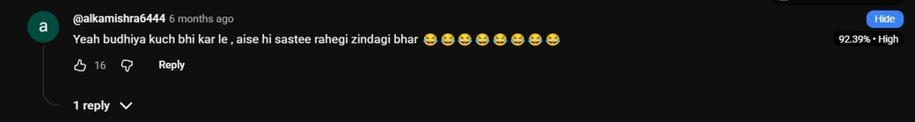
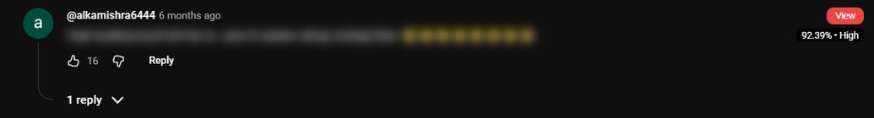
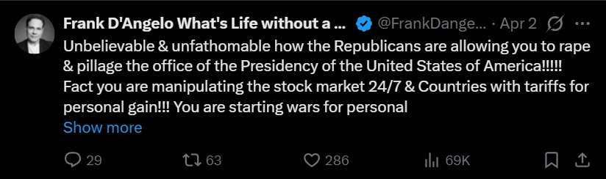
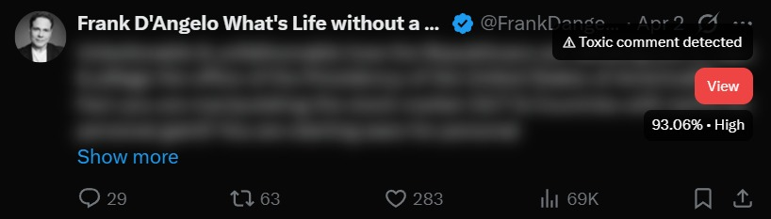
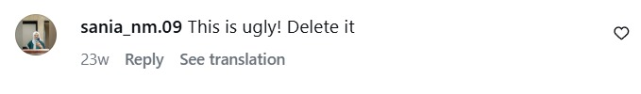
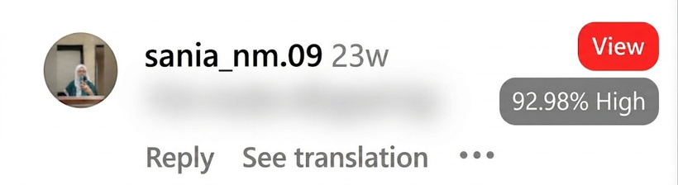
TEST CASES
BEFORE
AFTER

Slide 19

MODEL TRAINING &
DATASET
GROUP - 5
DATASET SOURCE
Collected from social media comments and public data sources.
STANDARD DATASET
Follows the Jigsaw Toxic Comment Classification dataset format.
DATA LABELING & SCORING
Each comment is classified into six categories (Toxic, Severe Toxic, Obscene, Threat, Insult, Identity Hate) using binary labels (0/1), with weighted scoring to compute overall toxicity.
FINAL CLASSIFICATION
Comments categorized into Low, Moderate, and High toxicity levels.
MODEL TRAINING
Model fine-tuned using XLM-RoBERTa for improved real-world performance.

Slide 20

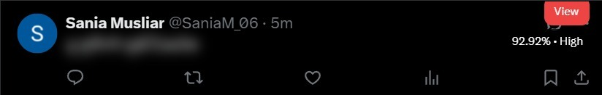

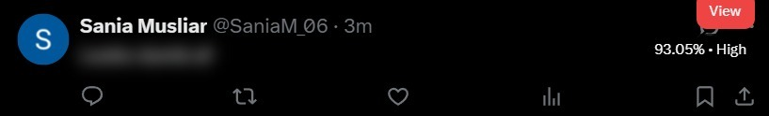

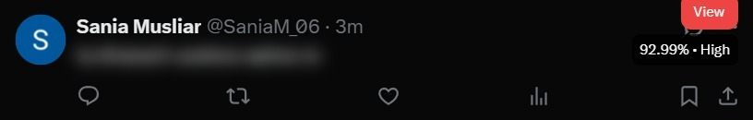
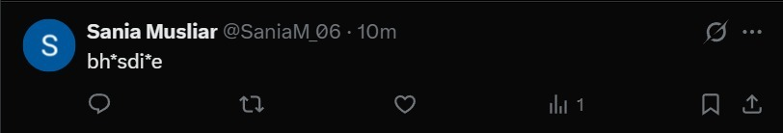
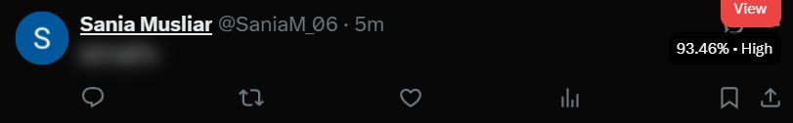
TEST CASES
BEFORE TRAINING THE AI MODEL
AFTER TRAINING THE AI MODEL

Slide 21
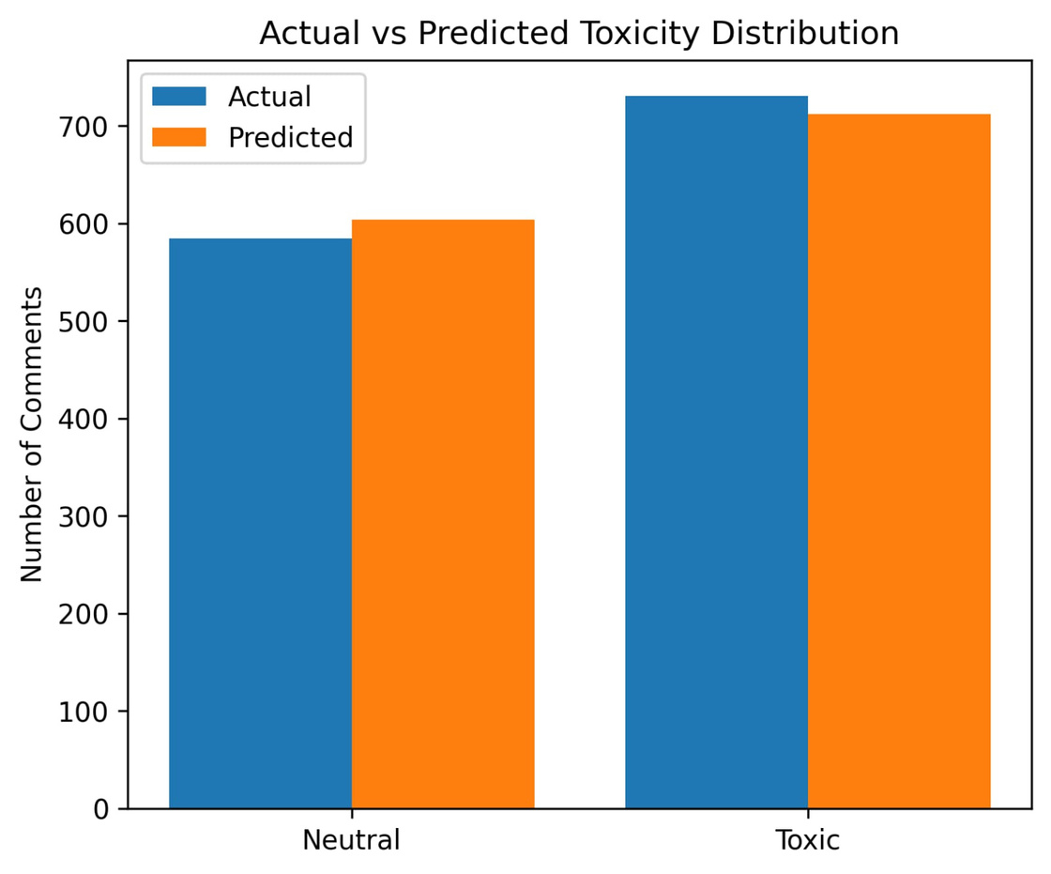
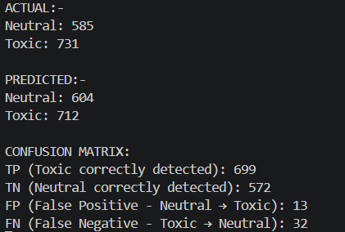
MODEL EVALUATION
GROUP - 5

Slide 22
IMPACTS
GROUP - 5
1.
SOCIETAL
2.
ENVIRONMENTAL
  Promotes safe and inclusive online spaces by detecting toxicity across multiple languages.
  Protects users’ mental health and encourages respectful digital interactions.
  Uses lightweight AI models to reduce computational energy usage.
  Browser-based design lowers reliance on energy-intensive cloud servers.

Slide 23
INNOVATIVENESS & FEASIBILITY
GROUP - 5
INNOVATIVENESS:
  Works across platforms, not tied to a single app.
  Real-time browser integration for instant action.
  Multilingual detection beyond English.
FEASIBILITY:
  Uses existing AI/NLP models (BERT, multilingual transformers).
  Browser extension framework supports cross-platform use.
  Scalable with cloud-based processing can be trained on publicly available datasets.

Slide 24
CONCLUSION
GROUP - 5
  Achieved real time detection of toxic and neutral messages across multiple languages.
  Improved accuracy and performance after fine-tuning the model.
  Successfully filters harmful content using blur, scoring, and user control features.
  Demonstrated strong potential for enhancing online safety through automated moderation in real time.

Slide 25
FUTURE SCOPE
GROUP - 5
1. VOICE AND IMAGE-BASED DETECTION
Detect offensive memes and images using computer vision models (e.g. CLIP). Identify abusive audio content using speech-to-text and toxicity classification.
2. CROSS-LANGUAGE TRANSLATION INTEGRATION
Integrate Google Translate or DeepL API to handle code-mixed and low-resourcelanguage comments before passing them to the detection model.
3. UNIVERSAL AI MODERATION SERVICE
Evolve ToxiShield into a standalone REST PI that any social media platformor third-party app can integrate for automated real-time content moderation.

Slide 26
REFERENCES
GROUP - 5
[1] Cyberbullying Detection of Resource-Constrained Language from Social Media using Transformer-Based Approach.
Authors: Sihab-Us-Sakib et al., 2024.
Cyberbullying Detection of Resource-Constrained Language from Social Media using Transformer-Based Approach
[2] BullStop: A Mobile App for Cyberbullying Prevention.
Authors: Semiu Salawu et al., 2020.
BullStop: A Mobile App for Cyberbullying Prevention Semiu Salawu, Yulan He & Jo Lumsden, 2020
[3] Intelligent Multi-Lingual Cyber-Hate Detection in Online Social Networks.
Authors: Donia Gamal et al., 2023.
Intelligent Multi-Lingual Cyber-Hate Detection in Online Social Networks: Taxonomy, Approaches, Datasets,
and Open Challenges
[4] Advancing Cyberbullying Detection: A Hybrid Machine Learning and Deep Learning Framework.
Authors: Bishal Shyam Purkayastha et al., 2025.
Advancing Cyberbullying Detection: A Hybrid Machine Learning and Deep Learning Framework for Social Media Analysis

Slide 27
SDG MAPPED
GROUP - 5
  SDG 3: Good Health & Well-being – Reduce mental health harm from cyberbullying.
  SDG 4: Quality Education – Promote safe digital learning spaces.
  SDG 10: Reduced Inequalities – Multilingual support for inclusivity.
  SDG 16: Peace, Justice & Strong Institutions – Promote safe and peaceful online communities.

Slide 28

GROUP - 5
PO & PSO
MAPPED
PO 1: Engineering knowledge
PO 2 : Problem analysis
PO 3 : Design/Development of solution
PO 5 : Engineering tool usage
PO 7 : Ethics
PO 11 : Life long learning
PSO 1 : Adapt to the technological advancements in the
field of Artificial Intelligence and Data Science
PSO 2: Problem Solving & Data-Driven Decision Making
PSO 3: Software Development & Deployment Skills

Slide 29
THANK
YOU!

Slide 30
FINAL REPORT
https://drive.google.com/file/d/1dNagp2kn0aGf5O1g3IcKYKxE9ARliOHE/view?usp=sharing

